Slide 1


Wild-Animal Detection Using Applied Machine Learning
This presentation explores the application of machine learning techniques to detect and classify wild animals in real-world settings.

Slide 2
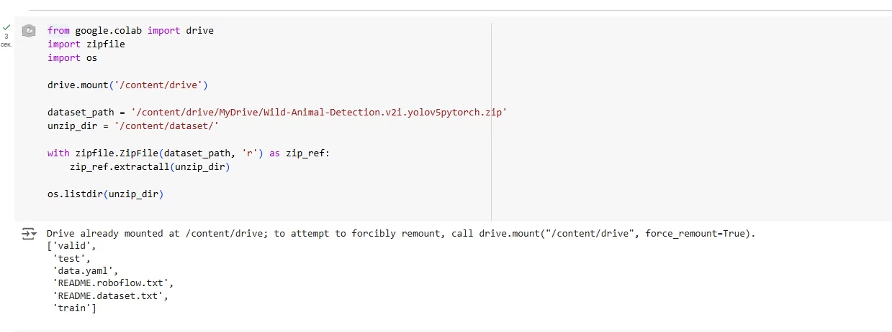
Data Loading and Preparation
Data Augmentation
ResNet50 Model
Using the TensorFlow.keras library and the ImageDataGenerator method, we perform data augmentation to improve model quality and avoid overfitting.
The ResNet50 model is applied, with generators used to load and prepare data with a size of 224x224 and a batch size of 512.

Slide 3
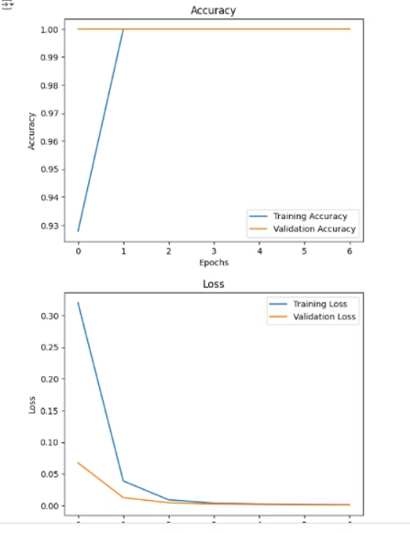
Training and Evaluation
1
Training Process
2
Visualization
The training process of the model is started here.
Training results are visualized, showing that the model trains very well, with no overfitting.

Slide 4
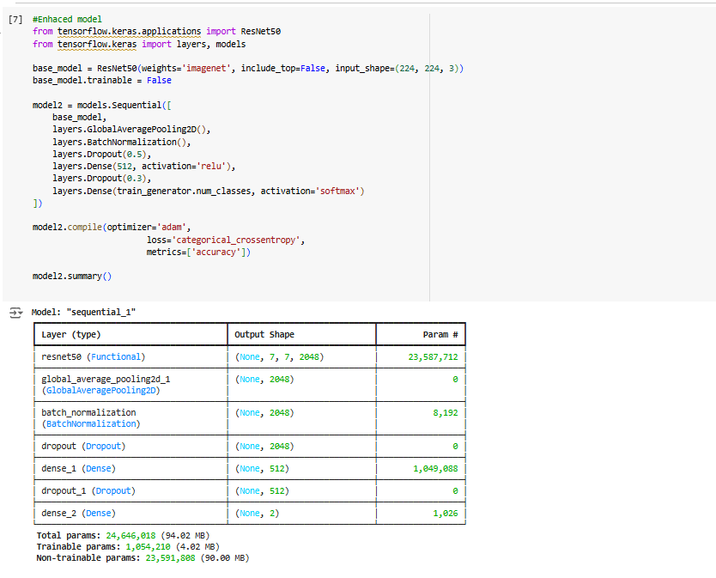
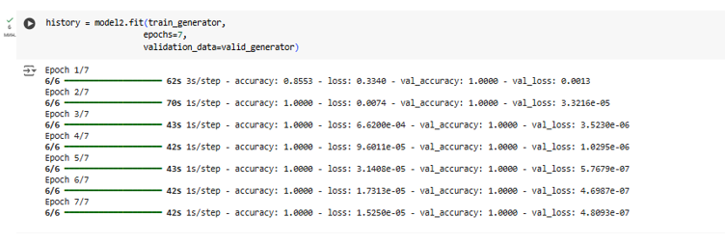

Model Enhancement
Enhanced Model
We apply a better model, ResNet50, by adding DropOut, BatchNormalization, and ReLU.
Improved Results
The results of the enhanced model are slightly better than the initial model.

Slide 5
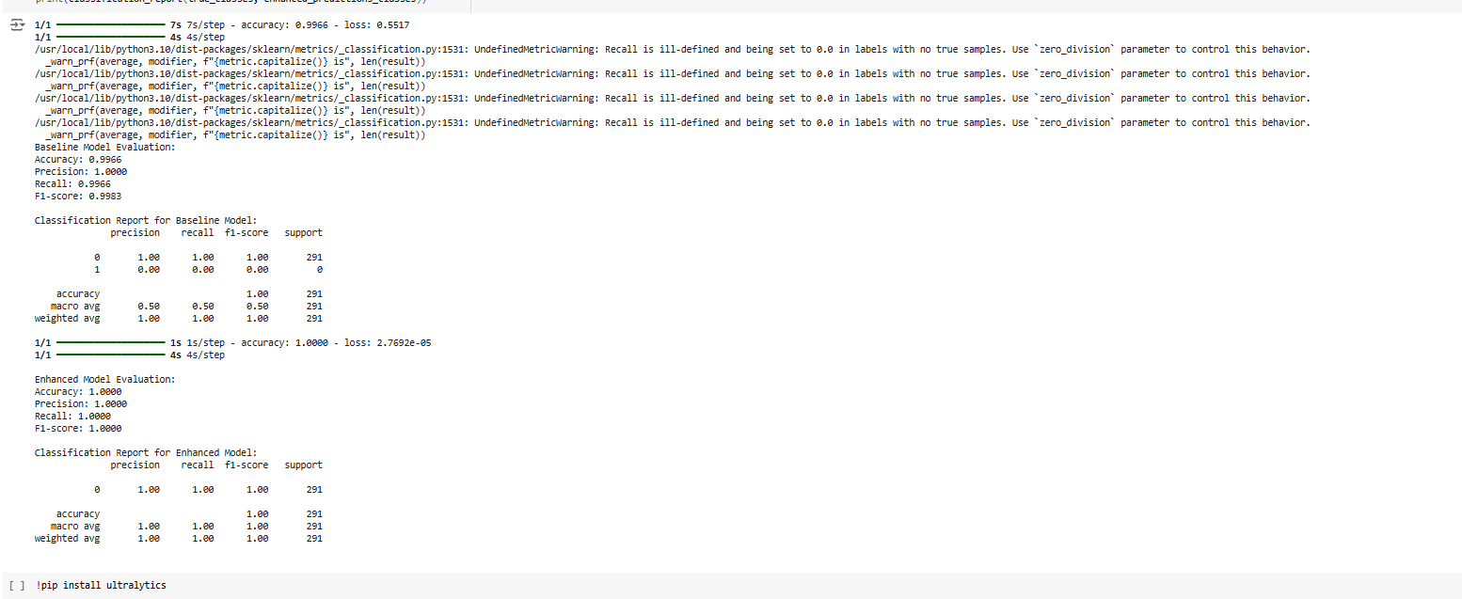
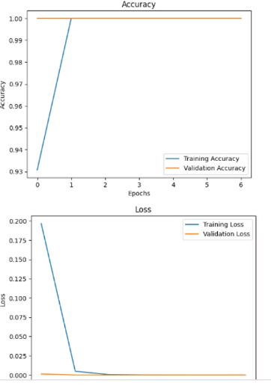

Visualizing Performance
Model Accuracy
These metrics show that the model works very well and is accurate.
Evaluation Metrics
We perform evaluation measurements of F1, precision, and recall.

Slide 6
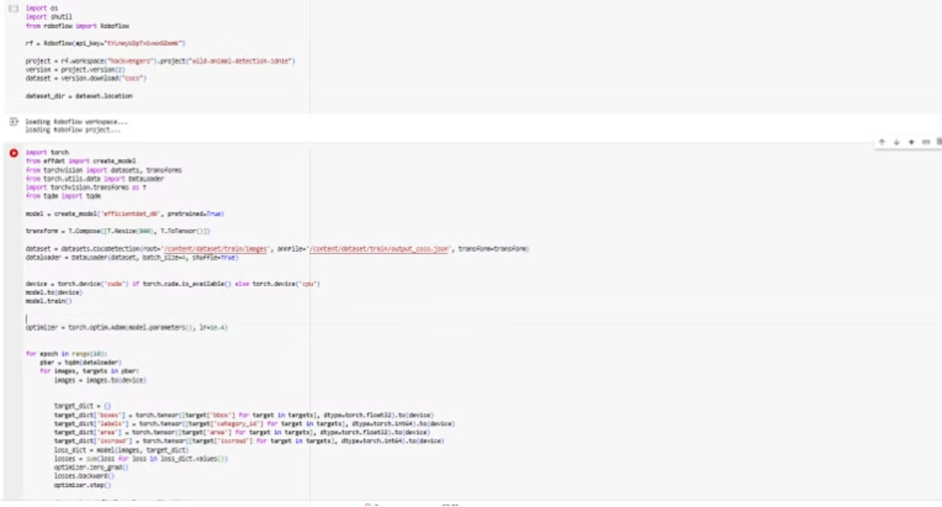

Next Steps: EfficientDet Implementation
EfficientDet
We apply EfficientDet, a state-of-the-art object detection model, and install the necessary resources.

Slide 7



Challenges and Future Directions
GPU Limitations
Many accounts were changed due to the laptop's inability to support the GPU system.
Time Constraints
Implementing the final steps with EfficientDet has become practically impossible due to lack of time.

Slide 8
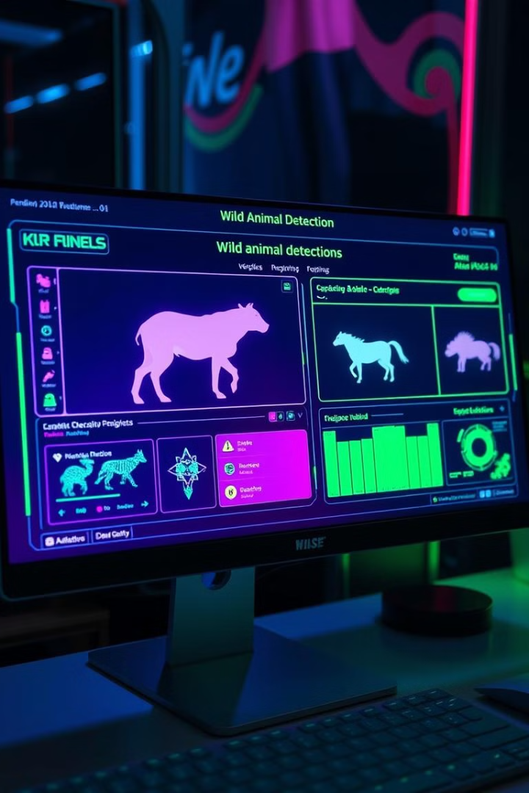
Conclusion
This project successfully explored the application of machine learning for wild-animal detection. We identified and addressed challenges related to data augmentation, model selection, and training optimization. Our findings demonstrate the potential of these techniques for real-world conservation efforts and wildlife monitoring.

